Slide 1
Food experiences of Syrian immigrants in the Netherlands
An exploratory study

Slide 2
Percentage of UE population living in urban areas

Slide 3
Ten fastest growing population groups in the NL with migrant background
(CBS, 2017)
x1000

Slide 4
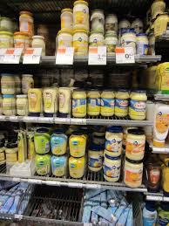
Dietary acculturation
Notes:
.

Slide 5
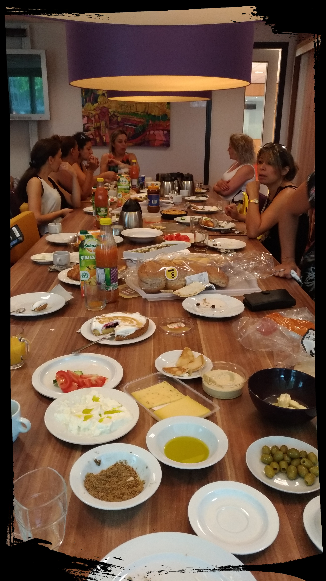
Research question
How do Syrians experience the interaction with their former and new food environment ?

Slide 6
Meal format
‘For breakfast I had bread with cheese, this is a typical Dutch breakfast. Our breakfast is completely different. We have a big table with a lot of different food ’

Slide 7
Availability of traditional food
‘We used to go to Germany to buy food.’
We buy Syrian cheese from Dutch farmers’
‘Turkeys and Syrian shops are everywhere.’

Slide 8
Preparation of traditional food
VS
’Technology makes cooking very hard.’
’ There are smells and flavours that you cannot forget.’

Slide 9
Conclusion
Drivers of change
Drivers of preservation
Lack of time
Availability of traditional food
New ways of cooking
Memories & Heritage food
Notes:
.

Slide 10
Further researches
Syrians eating patterns
Impact of the urbanized food environment on their dietary patterns
Interaction between Syrians food habits and Dutch food environment

Slide 11
Thank you for your attention!
Claudia Segreto, MSc
c.segreto@aeres.nl

